Slide 1
Bayesian Classification: Why?
A statistical classifier: performs probabilistic prediction, i.e., predicts class membership probabilities
Foundation: Based on Bayes’ Theorem.
Performance: A simple Bayesian classifier, naïve Bayesian classifier, has comparable performance with decision tree and selected neural network classifiers
Incremental: Each training example can incrementally increase/decrease the probability that a hypothesis is correct
Standard: Even when Bayesian methods are computationally intractable, they can provide a standard of optimal decision making against which other methods can be measured
Machine Leaning: An Introduction

Slide 2
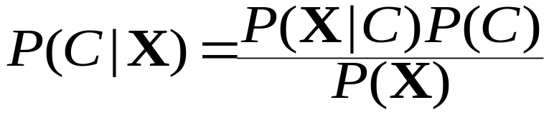
Bayesian Theorem: Basics
Let X be a data sample and C a class
P(C|X) : Proba that X belongs to class C given the attribute description of X
Given classes C₁, C₂ … C_{m} , we should assign X to the class C_{i} s.t. P(C_{i}|X) is maximum
We can assess P(C_{i}|X) using Bayes’ rule:
Machine Leaning: An Introduction

Slide 3
Bayesian Theorem (cont’d)
P(C): Proba that X belongs to class C independently of the attributes of X
P(X): Proba that sample data is observed
P(X|C): Proba of observing the sample X, knowing it belongs to class C
Practical difficulty: require initial knowledge of many probabilities, significant computational cost
Machine Leaning: An Introduction

Slide 4
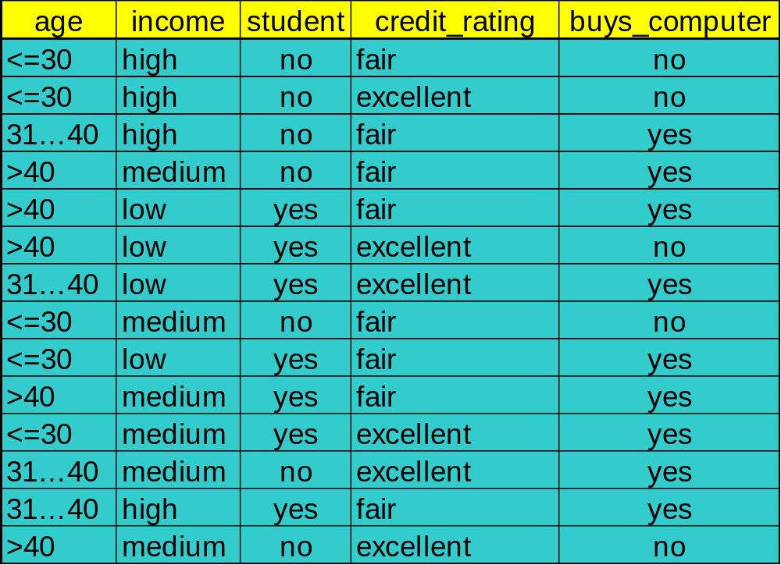
An example
Machine Leaning: An Introduction

Slide 5


Towards Naïve Bayesian Classifier
Let D be a training set of tuples and their associated class labels, and each tuple is represented by an n-D attribute vector X = (x₁, x₂, …, x_{n})
Suppose there are m classes C₁, C₂, …, C_{m}.
Classification should maximise P(C_{i}|X)
This can be derived from Bayes’ theorem
Since P(X) is constant for all classes, only
  needs to be maximized
Machine Leaning: An Introduction

Slide 6
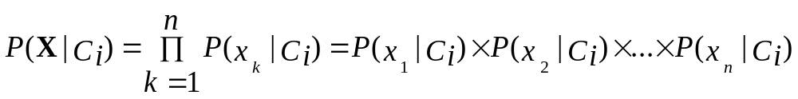
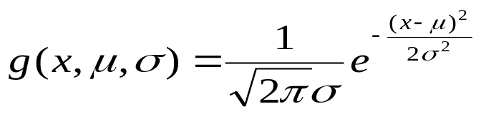

Derivation of Naïve Bayes Classifier
A simplified assumption: attributes are conditionally independent (i.e., no dependence relation between attributes):
This greatly reduces the computation cost: Only counts the class distribution
If A_{k} is categorical, P(x_{k}|C_{i}) is the # of tuples in C_{i} having value x_{k} for A_{k} divided by |C_{i, D}| (# of tuples of C_{i} in D)
If A_{k} is continous-valued, P(x_{k}|C_{i}) is usually computed based on Gaussian distribution with a mean μ and standard deviation σ
  and P(x_{k}|C_{i}) is
Machine Leaning: An Introduction

Slide 7

Naïve Bayesian Classifier: Training Dataset
Class:
C1:buys_computer = ‘yes’
C2:buys_computer = ‘no’
Data sample
X = (age <=30,
Income = medium,
Student = yes
Credit_rating = Fair)
Machine Leaning: An Introduction

Slide 8
Naïve Bayesian Classifier: An Example
P(C_{i}): P(buys_computer = “yes”) = 9/14 = 0.643
P(buys_computer = “no”) = 5/14= 0.357
Compute P(X|C_{i}) for each class
P(age = “<=30” | buys_computer = “yes”) = 2/9 = 0.222
P(age = “<= 30” | buys_computer = “no”) = 3/5 = 0.6
P(income = “medium” | buys_computer = “yes”) = 4/9 = 0.444
P(income = “medium” | buys_computer = “no”) = 2/5 = 0.4
P(student = “yes” | buys_computer = “yes) = 6/9 = 0.667
P(student = “yes” | buys_computer = “no”) = 1/5 = 0.2
P(credit_rating = “fair” | buys_computer = “yes”) = 6/9 = 0.667
P(credit_rating = “fair” | buys_computer = “no”) = 2/5 = 0.4
X = (age <= 30 , income = medium, student = yes, credit_rating = fair)
P(X|C_{i}) : P(X|buys_computer = “yes”) = 0.222 x 0.444 x 0.667 x 0.667 = 0.044
P(X|buys_computer = “no”) = 0.6 x 0.4 x 0.2 x 0.4 = 0.019
P(X|C_{i})*P(C_{i}) : P(X|buys_computer = “yes”) * P(buys_computer = “yes”) = 0.028
P(X|buys_computer = “no”) * P(buys_computer = “no”) = 0.007
Therefore, X belongs to class (“buys_computer = yes”)
Machine Leaning: An Introduction

Slide 9
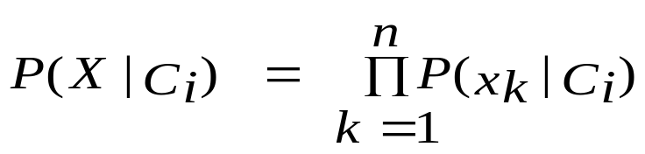
Avoiding the 0-Probability Problem
Naïve Bayesian prediction requires each conditional prob. be non-zero. Otherwise, the predicted prob. will be zero
Eg., suppose a dataset with 1000 tuples, income can be low (0 example), medium (990 ex.) or high (10 ex.),
Use Laplacian correction (or Laplacian estimator)
  Adding 1 to each case
    Prob(income = low) = 1/1003
    Prob(income = medium) = 991/1003
    Prob(income = high) = 11/1003
  The “corrected” prob. estimates are close to their “uncorrected” counterparts
Machine Leaning: An Introduction

Slide 10
Naïve Bayesian Classifier: Comments
Advantages
  Easy to implement
  Good results obtained in most of the cases
Disadvantages
  Assumption: class conditional independence, therefore loss of accuracy
  Practically, dependencies exist among variables
    E.g., hospitals: patients: Profile: age, family history, etc.
    Symptoms: fever, cough etc., Disease: lung cancer, diabetes, etc.
    Dependencies among these cannot be modeled by Naïve Bayesian Classifier
How to deal with these dependencies?
  Bayesian Belief Networks
Machine Leaning: An Introduction

Slide 11
Bayesian Belief Networks
Bayesian belief network allows a subset of the variables conditionally independent
A graphical model of causal relationships
  Represents dependency among the variables
  Gives a specification of joint probability distribution
Nodes: random variables
Links: dependency
X and Y are the parents of Z, and Y is the parent of P
No dependency between Z and P
Has no loops or cycles
X
Y
Z
P
Machine Leaning: An Introduction

Slide 12
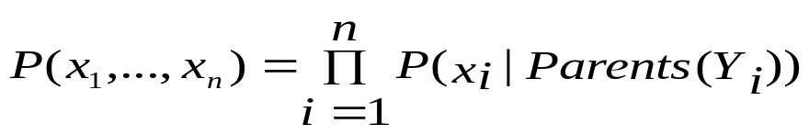
Bayesian Belief Network: An Example
Family
History
Smoker
The conditional probability table (CPT) for variable LungCancer:
(FH, S)
(FH, ~S)
(~FH, S)
(~FH, ~S)
LC
0.8
0.5
0.7
0.1
LungCancer
Emphysema
~LC
0.2
0.5
0.3
0.9
CPT shows the conditional probability for each possible combination of its parents
PositiveXRay
Dyspnea
Derivation of the probability of a particular combination of values of X, from CPT:
Bayesian Belief Networks
Machine Leaning: An Introduction

Slide 13
Training Bayesian Networks
Several scenarios:
Given both the network structure and all variables observable: learn only the CPTs
Network structure known, some hidden variables: gradient descent (greedy hill-climbing) method, analogous to neural network learning
Network structure unknown, all variables observable: search through the model space to reconstruct network topology
Unknown structure, some hidden variables: No good algorithm known yet for this purpose
Machine Leaning: An Introduction

